Slide 1

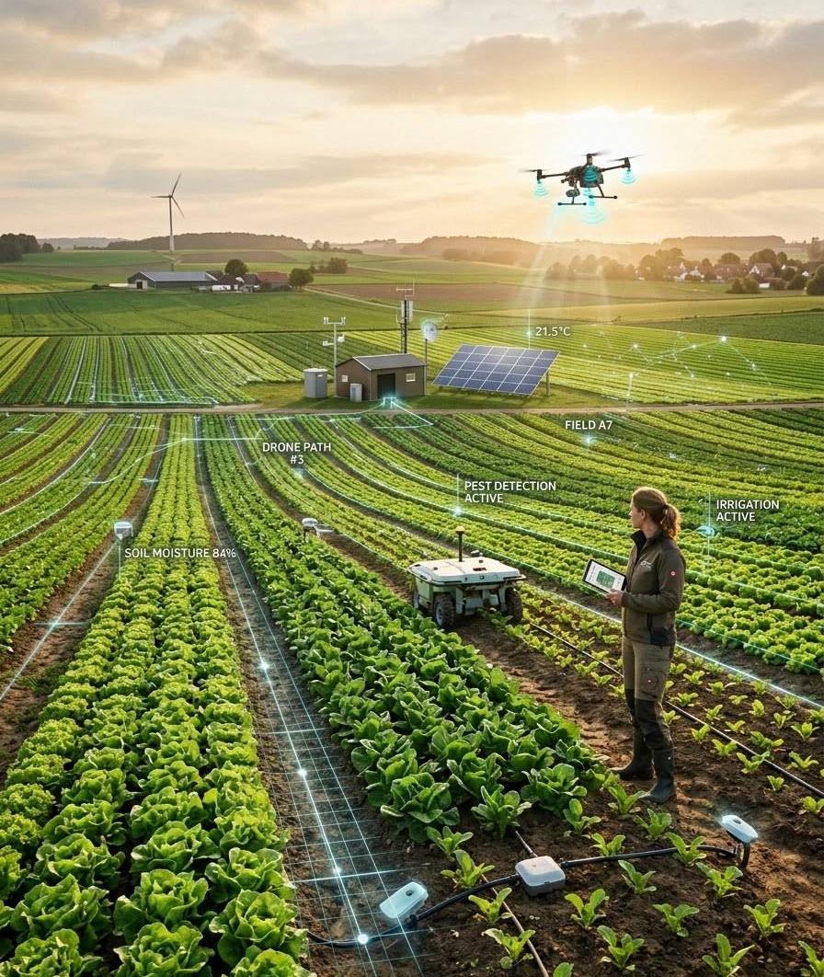
AgriVerse
Intelligent Farm Operations Platform with a Smart Agro Precision System
THEME
Agriculture, Food Tech & Rural Development
PRESENTED BY
Team C
MEMBERS
Puspal Das · Mittapalli Praharsha
Muthyala Meghana · Ramanaboina Sowjanya
GUIDE
Ragul S

Slide 2

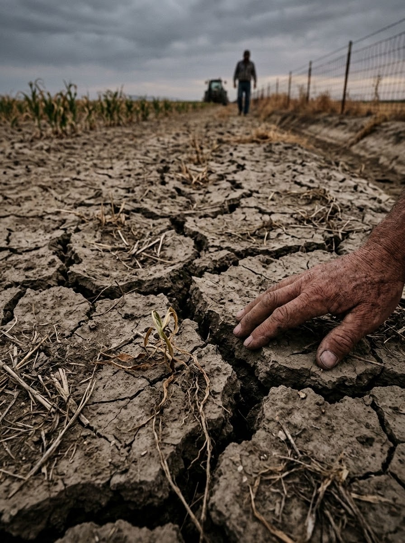
THE CHALLENGE
Problem Statement
Agriculture faces systemic inefficiencies due to limited access to modern digital technologies and integrated farming solutions.
01
Lack of a unified platform for managing agricultural activities.
02
Limited access to expert guidance for crop planning and disease management.
03
Delayed pest identification leading to significantly reduced crop productivity.
04
Limited access to real-time weather forecasts and market price information.
05
Inefficient record management and decision-making processes.

Slide 3
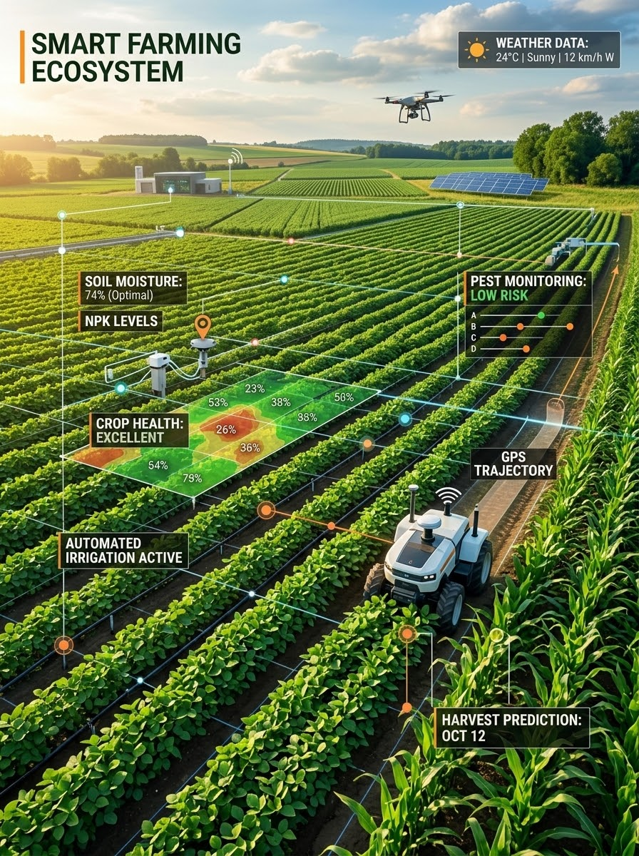
THE SOLUTION
Proposed Solution & Objectives
Agriculture remains one of the most important sectors of the economy, yet many farmers face challenges due to limited access to modern digital technologies and integrated farming solutions.
01
Lack of a unified platform for managing agricultural activities
02
Limited access to expert guidance for crop planning and disease management
Delayed pest identification leading to reduced crop productivity
03
Limited access to real-time weather forecasts and market price information
04
05
Inefficient record management and decision-making processes

Slide 4

TECH STACK ARCHITECTURE
Technology & Implementation
A robust, scalable end-to-end architecture built with modern web technologies, secure backend services, and cloud-ready deployment toolings.
01 Frontend Layer
02 Backend Core
HTML5, CSS3, Vanilla JS
Responsive user interface designed for optimal performance, smooth interactions, and cross-browser accessibility.
Spring Boot & REST APIs
Enterprise-grade Java backend providing robust RESTful web services, modular architecture, and high throughput.
03 Security & Auth
04 Data Architecture
Spring Security & JWT
Stateless authentication, role-based access control, and encrypted token management for enterprise protection.
MongoDB & Spring Data JPA
Flexible document storage paired with powerful object mapping for reliable and scalable data persistence.
05 Build & Version Operations
Maven, Git & GitHub
Standardized dependency lifecycle management via Maven combined with collaborative Git workflow repositories.

Slide 5

SYSTEM ARCHITECTURE
System Architecture & Workflow
A modular, end-to-end cloud platform designed for scalable AI advisory, secure authentication, and real-time data processing.
01 Three-Tier Architecture
02 Data Flow Pipeline
Frontend → Spring Boot → AI Service
Frontend connects to a robust Spring Boot API, which integrates with a specialized Spring AI Microservice for modularity.
Authentication & Request Routing
Requests are authenticated by Spring Security, routed via @RestController to MongoDB Atlas before delivering a response.
03 AI Advisory Pipeline
04 Database Infrastructure
Google Gemini & Disease AI
Transforms raw images via Google Gemini API for real-time generative advisory and advanced crop disease classification.
MongoDB Atlas Collections
MongoDB stores complex application and telemetry data using highly scalable NoSQL Document Collections.
05 Authentication & Authorization Security
Spring Security, JWT & Role-Based Control
Stateless, enterprise-grade authentication powered by Spring Security and JWT, enforcing strict role-based access control policies customized for Farmers, Vets, and Admins.

Slide 6
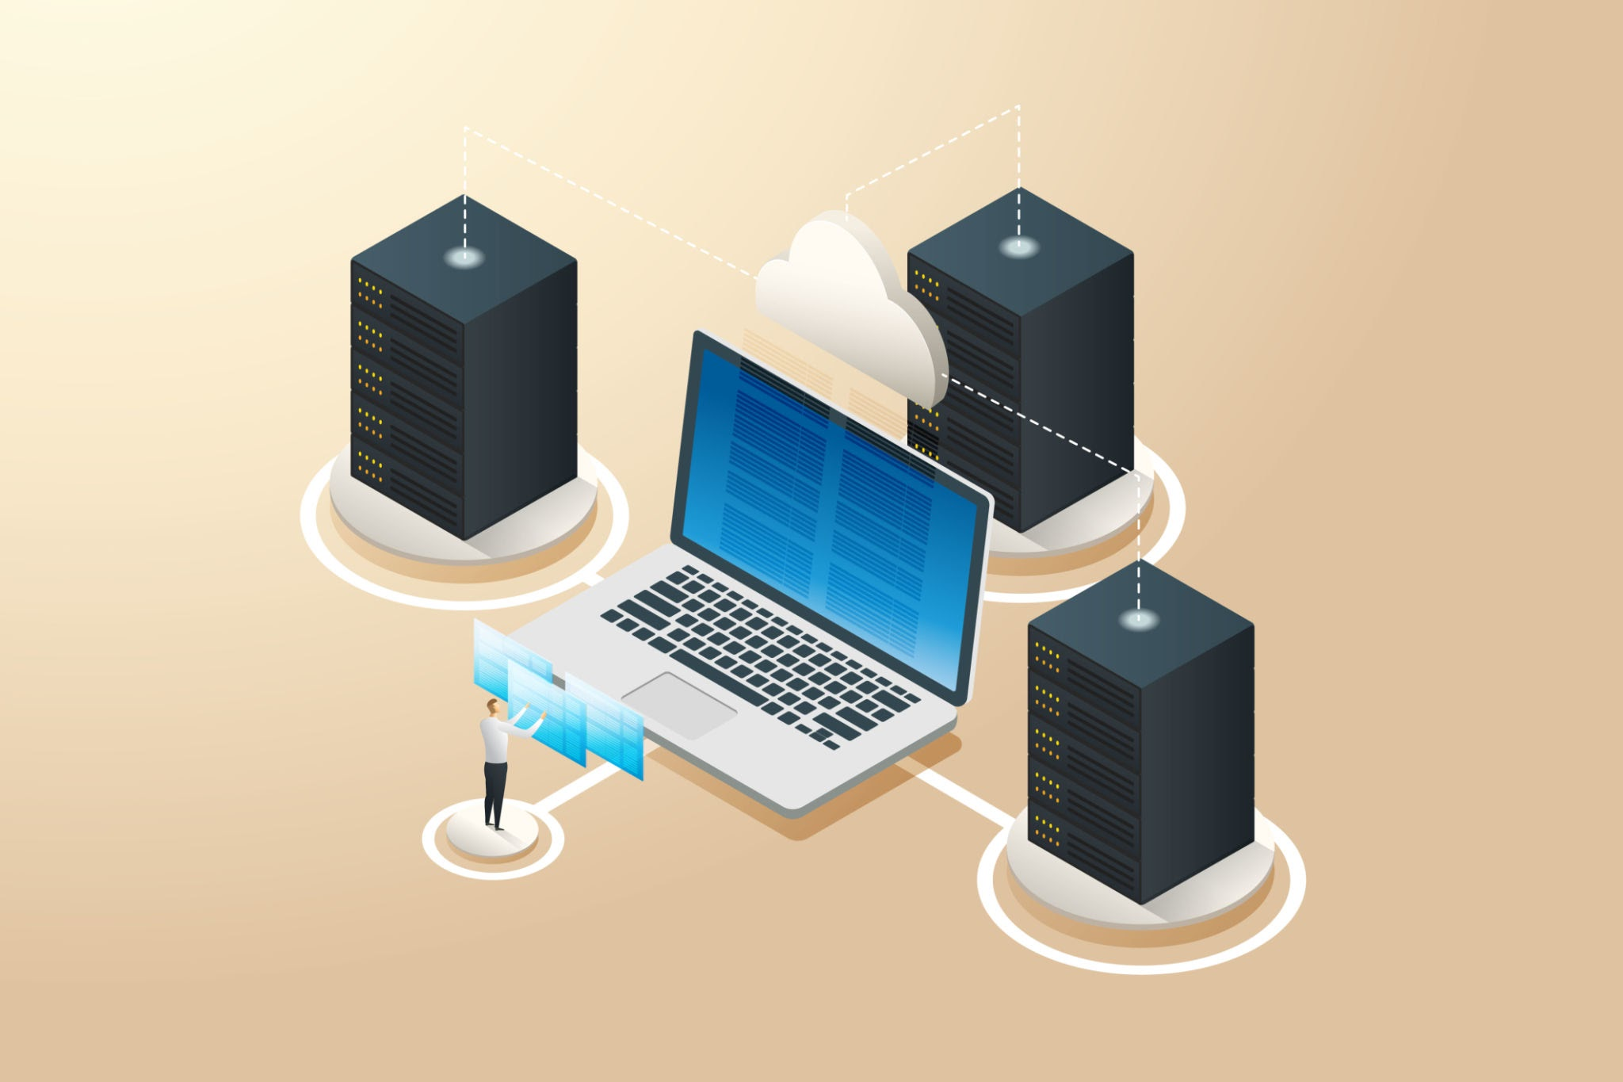
DATABASE ARCHITECTURE
Database Design & Schema
MySQL stores all application data using relational tables structured for high performance and integrity.
01 Users
02 Crops
03 Products
Authentication, roles, and profile details for farmers, buyers, and administrators.
Crop records with planting details, disease status, and cultivation metadata.
Marketplace product listings linked directly to crop inventory and availability.
04 Orders
05 Consultations
06 Weather
Purchase transactions, order status tracking, quantities, and delivery details.
Expert advice sessions, diagnosis notes, and tailored farming recommendations.
Location-based forecasts, weather alerts, and environmental condition logs.
07 Marketplace & Interactions
Comprehensive listings, dynamic pricing structures, item categories, and direct buyer-seller interactions across the entire platform ecosystem.

Slide 7

SYSTEM WORKFLOW & SECURITY
Application Workflow & Access Control
AgriVerse ensures secure access through role-based authentication and controlled application workflow.
Application Workflow
01
User Login
Credentials submission via portal
02
Role Verification
Identifies Farmer, Vet, or Admin
03
JWT Auth
Generates secure session token
04
Dashboard
Loads personalized user interface
05
Access Features
Grants authorized module tools
01
Spring Security
Robust framework providing comprehensive authentication and authorization protection.
02
JWT Auth
Stateless token-based authentication enabling secure, scalable API request routing.
03
Role-Based Access
Strict permission policies tailored specifically for Farmers, Vets, and Administrators.

Slide 8
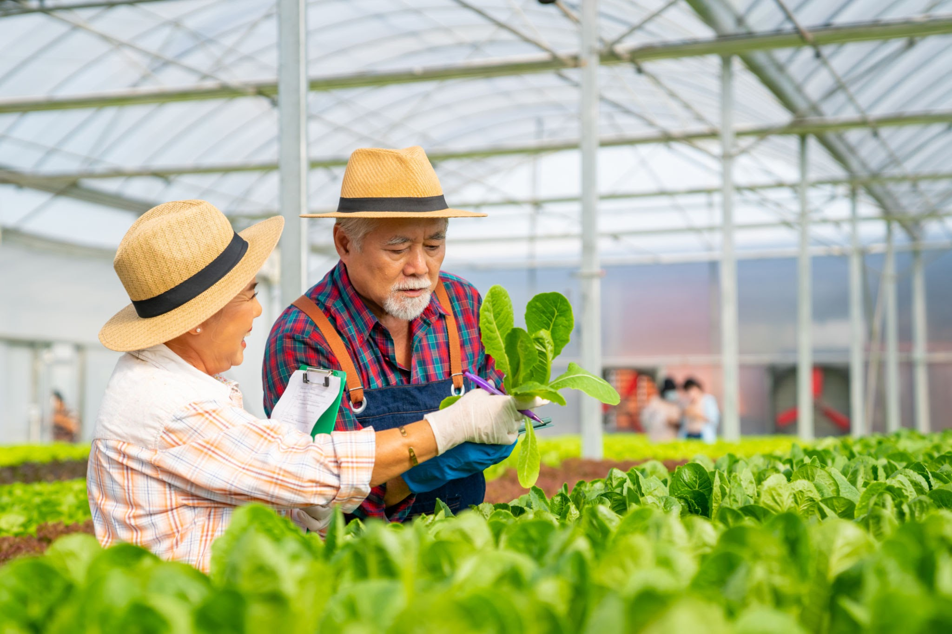
CORE FEATURES & MODULES
Complete Digital Farming Ecosystem
Combining secure farm management, intelligent decision support, and role-based services on a single platform.
Core Features
Application Modules
AI & Smart Services
01
Secure Authentication
01
Farmer Portal
01
AI Crop Advisory
02
Crop Management
02
Expert Portal
02
Pest Detection
03
Weather Insights
03
Marketplace
03
Weather Analysis
04
Digital Marketplace
04
Admin Dashboard
04
Market Price Insights
05
Analytics Dashboard
05
Role-Based Access
05
Smart Recommendations

Slide 9
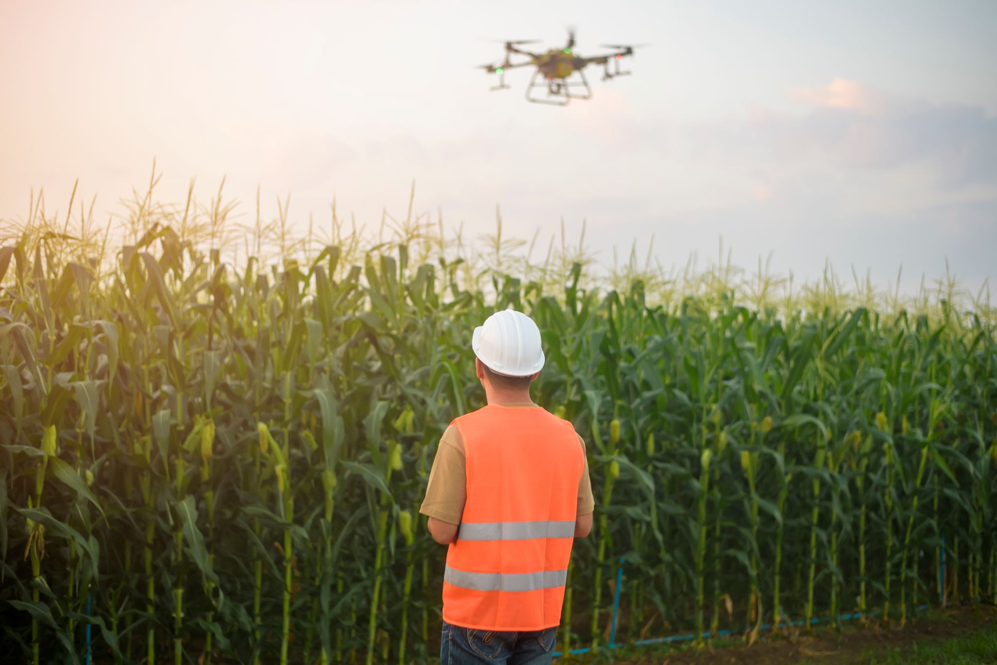
KEY INNOVATIONS
Intelligent & Scalable Digital Farming
AgriVerse combines modern Java Full Stack technologies with AI-powered services.
01
Real Time Generative Advisory
Personalized crop recommendations based on farming data.
02
Secure Access
JWT authentication with role-based authorization.
03
Smart Insights
Real-time weather and market price updates.
04
Digital Marketplace
Direct farmer-to-buyer trading platform.
05
Analytics Dashboard
Visual reports for better decision-making.

Slide 10

MARKET POSITIONING
Competitive Advantage
How AgriVerse outperforms traditional farming approaches across key metrics.
FEATURE
TRADITIONAL METHODS
AGRIVERSE
Crop Management
Manual
Digital
Expert Consultation
Offline
Online
Weather Insights
Separate Apps
Integrated
Marketplace
Middlemen
Direct Trading
AI Recommendations
Not Available
Intelligent Advisory
Secure Platform
Limited
JWT + Spring Security

Slide 11

EXPANSION ROADMAP
Future Scope & Strategic Roadmap
Scaling AgriVerse with advanced hardware, deep AI predictions, and expanded financial ecosystem.
01
IoT Sensor Integration
Seamlessly integrate data from soil, weather, and crop health sensors for real-time insights.
02
Drone Monitoring
Utilize drones for aerial imaging, automated pest detection, and comprehensive crop analysis.
03
AI Prediction Improvement
Enhance AI models for more accurate yield predictions, disease forecasting, and resource management.
04
Mobile Application
Develop a dedicated mobile app for farmers to access AgriVerse features on-the-go.
05
Government Scheme Integration
Integrate with government agricultural schemes and subsidies to provide farmers with direct support.
06
Online Payments
Implement secure online payment gateways for marketplace transactions and expert consultations.

Slide 12

RESULTS & IMPACT
Results & Benefits
Empowering farmers with data-driven operations, intelligent insights, and direct connectivity.
01
Improved Farm Management
Centralized management of crops, farming activities, and records.
02
Smarter Decisions
AI-based recommendations and real-time information support better decisions.
03
Early Detection
Helps identify crop-related issues faster and take timely action.
04
Real-Time Insights
Weather conditions and market prices are available in one platform.
05
Market Connectivity
Enables direct interaction between farmers and buyers, reducing middlemen.
06
Secure Access
Role-based authentication provides secure access for different users.

Slide 13
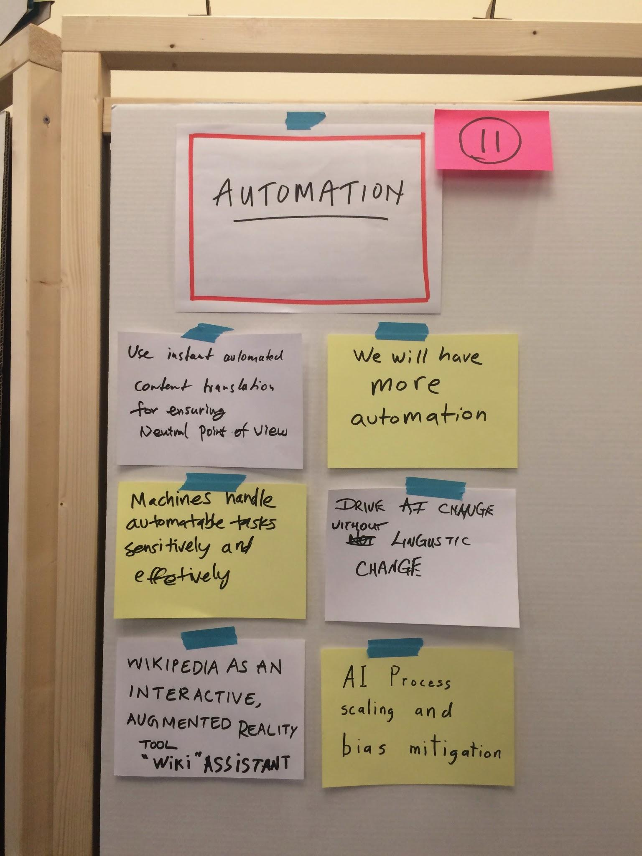
CONCLUSION
Summary & Key Takeaways
Transforming modern agriculture through a unified, secure, and intelligent ecosystem.
01
Unified Platform
Addresses core agricultural challenges by integrating essential operations into one seamless digital hub.
Crop Management & Weather Insights
AI Crop Advisory & Pest Detection
Expert Consultations
Digital Marketplace & Price Info
02
Scalable Architecture
Built on robust modern technologies to support scalable growth and enterprise-grade security.
HTML5, CSS3 & Vanilla JavaScript
Spring Boot, REST APIs & MongoDB
Spring Security & JWT Auth
Role-based Multi-user Access
03
Farmer Empowerment
Drives digital transformation across agricultural workflows to maximize farming efficiency.
Data-Driven & Faster Decisions
Optimized Crop Planning
Centralized Activity Management
Direct Buyer Connections

Slide 14

DISCUSSION & COLLABORATION
Thank You
We welcome questions, critiques, and collaborations as we build the future of smart farming.
PRESENTED BY
Team C
AgriVerse Core Team
PROJECT GUIDE
Rahul S
Strategic Advisor
Questions & Open Floor
Feel free to share your thoughts, ideas, or feedback.

